Slide 1
August 2022
Jared Lou, CFA
FOR USE WITH INSTITUTIONAL INVESTORS ONLY.
As used in this document, “William Blair” refers to William Blair Investment Management, LLC and affiliates unless otherwise noted.
001A5C8A

Slide 2
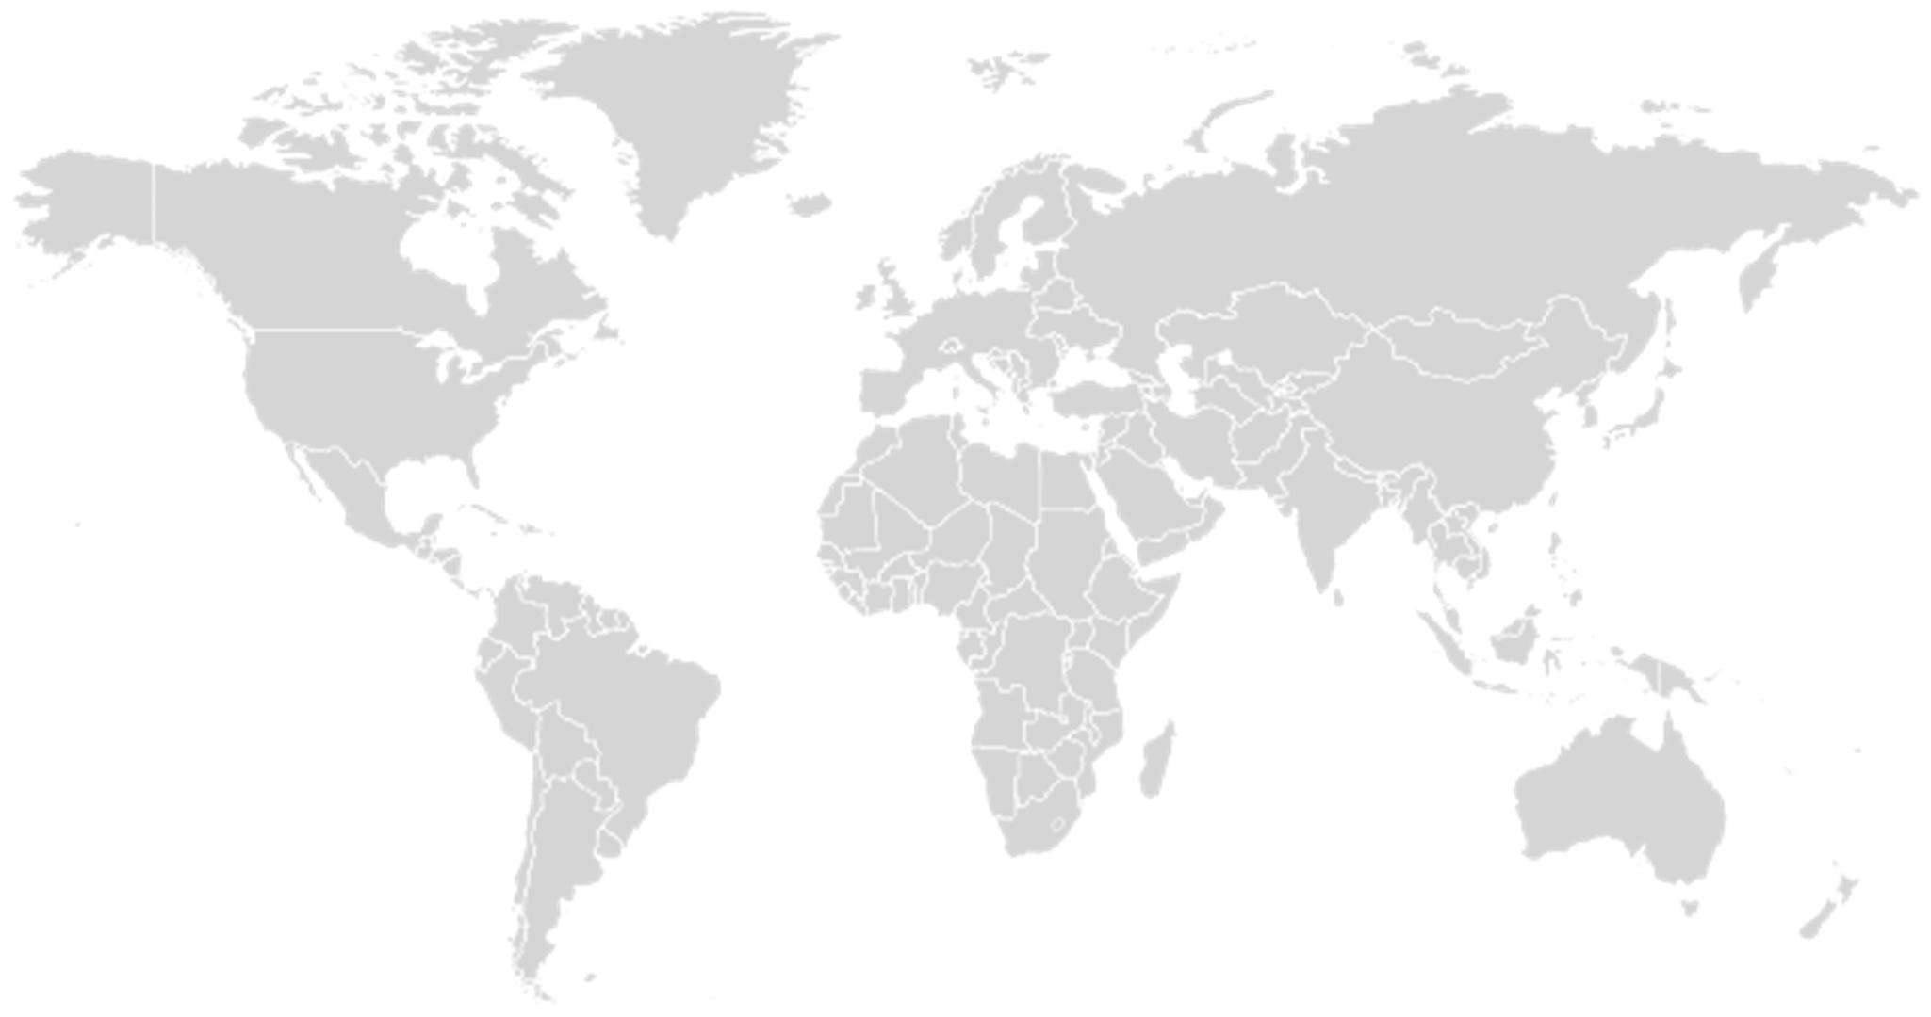
Agenda
Emerging Markets Debt
What is Emerging Markets Debt
Why Invest in Emerging Markets Debt
Why Invest in Emerging Markets Debt Now
Outlook & Opportunities
001D9FDF
2

Slide 3
What is Emerging Markets Debt
00003248
3

Slide 4
What is Emerging Markets Debt?
The Emerging Markets Debt (EMD) investable universe is composed of:
Fixed Income Securities issued by emerging market governments and companies
Hard Currencies (U.S. dollar, Euro, British Pound, Japanese Yen, etc.)
Local Currencies (Brazilian Real, Mexican Peso, South African Rand, etc.)
Over
900
Issuers
Over
90
Countries
Over
$4.5T
Market
Capitalization
Source: JP Morgan, William Blair.
001D870D
4

Slide 5
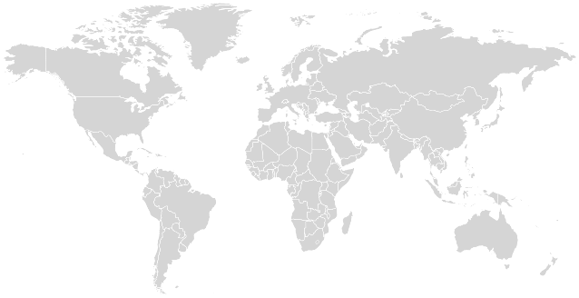
Depth of the EMD Universe
The Emerging Markets Debt (EMD) investable universe is composed of:
Sovereign Debt
Quasi-Sovereign Debt
Corporate Debt
• Poland
• Peoples Rep. of China
• SINOPEC
• TENCENT
• United Mexican States
• PEMEX
• CEMEX SAB de CV
• UAE
Tata Steel •
• India Export Import Bank
• Nigeria
• Seplat
Rep. of Brazil •
BNDES •
BANCO ITAU •
Rep. of Indonesia •
Pertamina •
Rep. of South Africa•
AngloGold •
References to specific issues or companies are for illustrative purposes only and should not be construed as investment advice or a recommendation to buy or sell any security.
001D870E
5

Slide 6
Emerging Markets Debt Indices
Benchmark
Coverage
Benchmark Inception
Currency
Countries Represented
Number of Issuers
Number of Instruments
Average Rating
Duration (Years)
Yield to Maturity
Market Cap ($B USD)
Long-Term Default Rate (Average 1/20 – 12/20)
Hard Currency Sovereign
JP Morgan EMBI Global Diversified (GD)
USD Sovereign & Quasi-Sovereign debt with caps on country weights to improve diversification
1999
USD
70
160
953
BBB-
6.82
8.57%
$609
1.0%*
Hard Currency Frontier Markets
JP Morgan NEXGEM
USD denominated Govt. bonds issued by Frontier Markets
2011
USD
35
42
145
B
4.96
13.56%
$98
1.5%
Hard Currency Corporates
JP Morgan CEMBI Broad Diversified
USD denominated bonds, >300M issuance, country and issuer capped
2008
USD
60
799
2046
BBB-
4.46
7.09%
$518
1.55%**
Local Currency Sovereign
JP Morgan GBI-EM Global Diversified (GD)
Sovereign debt issued in local currencies
2006
Local Currency
20
20
299
AA-
4.91
7.06%
$1,194
None
As of June 30, 2022.
*JP Morgan EMBI Global , **JP Morgan CEMBI Broad.
Source: JP Morgan. A direct investment in an unmanaged index is not possible.
001F0327
6

Slide 7

Why Invest In Emerging Markets Debt
00003249
7

Slide 8
Risk-Return of EMD Sub-Asset Classes
EMD Has Outperformed Many Other Asset Classes Over the Long Term With Less Risk
Under-Ownership
Institutional investors remain under-allocated to EMD
EMD remains under-represented in global fixed income indices
Inefficiency
Under-researched, under-reported universe creates opportunities for rigorous research to unlock alpha
Undervaluation
Risk Premia overcompensates for volatility, default and loss given default risks
Yield
Yield advantage over developed market bonds
Fifteen Years Ended June 30, 2022
We Believe There Are Significant Alpha Generation Opportunities
Source: FactSet
Past performance is not indicative of future returns. A direct investment in an unmanaged index is not possible. Please refer to the appendix for additional index information. Benchmarks used: EMD Hard Currency - JP Morgan EMBI Global Diversified Index; EM Local Currency - JPM Morgan GBI EM Global Diversified Index; EM Corporate Debt - JP Morgan CEMBI Diversified Index; Frontier Markets Debt - JP Morgan Next Generation Markets Index; Euro High Yield - MSCI Euro High Yield Index; U.S. High Yield - JP Morgan U.S. High Yield Index; U.S. Investment Grade - JP Morgan U.S. IG Corporate Index; U.S. Treasuries - Bloomberg U.S. Treasury Bills Index; MSCI Emerging Markets Index; MSCI EAFE Index; MSCI World Index.
001A5C96
8

Slide 9
EM Debt Has Displayed Lower Default Rates Historically
Higher Adjusted Yields
 | Yield | Spread | Duration | S&P Rating | Default Rate Historical | Recovery Value Historical | Adjusted Yield | Adjusted Yield/Duration
EMD Hard Currency Corporate | 6.38 | 350 | 4.6 | BBB- | 1.50 | 40 | 5.48 | 1.20
EMD Hard Currency Sovereign IG | 4.69 | 165 | 8.4 | A- |  |  | 4.69 | 0.56
EMD Hard Currency Sovereign HY | 10.65 | 774 | 5.6 | B+ | 2.00 | 55 | 9.75 | 1.74
EMD Hard Currency SAA¹ | 8.01 | 507 | 6.2 | BB+ |  |  | 7.38 | 1.28
US Corporate Credit HY | 7.17 | 434 | 4.2 | BB- | 3.50 | 35 | 4.90 | 1.18
US Core Fixed Income | 3.38 | 60 | 6.5 | AA+ |  |  | 3.38 | 0.52
US Treasury Index | 2.80 |  | 6.5 | AA+ |  |  | 2.80 | 0.43
¹EMD SAA: 20% CEMBI BD, 30% EMBIGD IG, 50% EMBIGD HY
As of July 2022.
Past performance is not indicative of future returns. A direct investment in an unmanaged index is not possible. Please refer to the appendix for additional index information. Benchmarks used:
EMD Hard Currency Corporate - JP Morgan CEMBI Diversified Index; EMD Hard Currency Sovereign - JP Morgan EMBI Global Diversified Index; US Corporate Credit High Yield - JP Morgan
U.S. High Yield Index; US Core Fixed Income – Bloomberg U.S. Aggregate Index; US Treasury - Bloomberg U.S. Treasury Bills Index;
Historical default rates: December 2000 to December 2020; Source J.P. Morgan, Moody’s
Historical recovery values - December 2000 to December 2020; Source J.P. Morgan, Moody’s
Yield adjusted by historical default rates, historical recovery values and duration. - Over time, investors may lose a percentage of their investment annually because of credit defaults. However, a credit default leads to a restructuring of the bonds. Historically, investors recovered on average around half of the money invested in bonds that have defaulted after the debt has been restructured. Finally, we divide adjusted yield by duration of the asset class. That will result in a yield adjusted by potential credit risk and duration.
The credit quality of securities in the portfolio and Index are sourced from Standard & Poor’s, Copyright © 2022, S&P Global Market Intelligence (and its affiliates, as applicable). Reproduction of any information, data or material, including ratings (“Content”) in any form is prohibited except with the prior written permission of the relevant party. Such party, its affiliates and suppliers (“Content Providers”) do not guarantee the accuracy, adequacy, completeness, timeliness or availability of any Content and are not responsible for any errors or omissions (negligent or otherwise), regardless of the cause, or for the results obtained from the use of such Content. In no event shall Content Providers be liable for any damages, costs, expenses, legal fees, or losses (including lost income or lost profit and opportunity costs) in connection with any use of the Content. A reference to a particular investment or security, a rating or any observation concerning an investment that is part of the Content is not a recommendation to buy, sell or hold such investment or security, does not address the suitability of an investment or security and should not be relied on as investment advice. Credit ratings are statements of opinions and are not statements of fact. Credit quality designations range from AAA (highest) to D (lowest). Credit quality ratings on underlying securities are received from S&P and Moody’s which are converted to the equivalent S&P major rating category for presentation purposes only.
0020B178
9

Slide 10
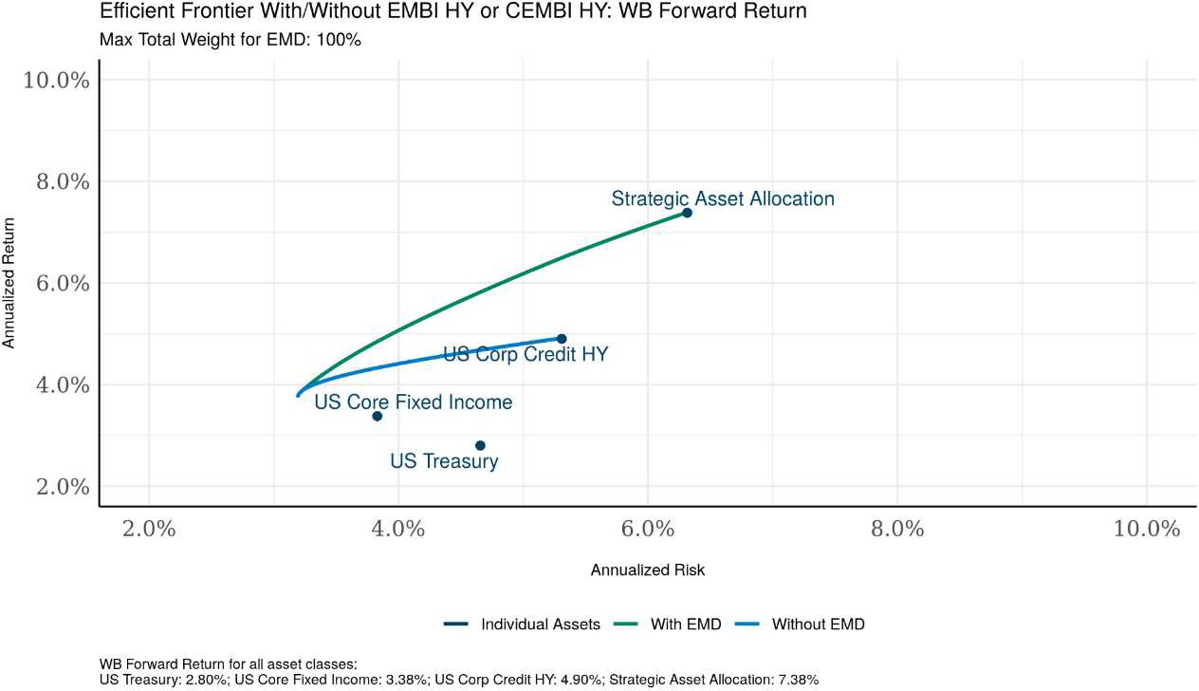
Adding EM Debt to a US Fixed Income Portfolio
Improved Expected Risk-Return Characteristics Based On Historical Default Rates
EMD Strategic Asset Allocation: 20% CEMBI BD, 30% EMBIGD IG, 50% EMBIGD HY.
Efficient frontier: An efficient frontier is a set of investment portfolios that are expected to provide the highest returns at a given level of risk. A portfolio is said to be efficient if there is no other portfolio that offers higher returns for a lower or equal amount of risk. Where portfolios are located on the efficient frontier depends on the investor’s degree of risk tolerance. Adding EMD assets to the potential asset mix has historically been accretive to the risk/return profile of the base U.S. fixed income portfolio. Efficient Frontier Analysis Parameters: 20 years of historical returns, correlations, historical returns and volatilities, using monthly observations.
The efficient frontier depicts hypothetical combinations of asset classes and is provided for illustrative purposes only. Hypothetical performance results do not represent the actual results of any account or strategy and are not indicative of the future performance of any strategy. Hypothetical performance results have many inherent limitations. In particular, they do not reflect actual trading and may not reflect the impact that material economic and market factors might have had on the decision-making process if actual accounts were managed using the strategy. Hypothetical performance also is developed with the benefit of hindsight, which may distort returns. The deduction of fees and expenses would reduce the returns shown. No investor should rely solely upon this hypothetical performance in making an investment decision.
As of June 2022. Source: J.P. Morgan, Bloomberg.
Past performance is not indicative of future returns. A direct investment in an unmanaged index is not possible. Please refer to the appendix for additional information.
Benchmarks used: EMD Hard Currency Corporate - JP Morgan CEMBI Diversified Index; EMD Hard Currency Sovereign IG - JP Morgan EMBI Global Diversified IG Index; EMD Hard Currency Sovereign HY - JP Morgan EMBI Global Diversified HY Index; US Corporate Credit High Yield - JP Morgan U.S. High Yield Index; US Core Fixed Income – Bloomberg U.S. Aggregate Index; US Treasury - Bloomberg U.S. Treasury Bills Index;
0020B179
10

Slide 11
Why Invest In Emerging Markets Debt Now
0000324A
11

Slide 12
Why Invest In Emerging Markets Debt?
EM High-Yield Spreads Appear Cheap–Particularly vs. U.S. High-Yield
EM Investment Grade Sovereign Spread
EM High-Yield Sovereign Spread
10-Year Average
EM High-Yield Sovereign Spread Minus EM Investment Grade Sovereign Spread
EM Sovereign High-Yield Spread Minus US High-Yield Spread
As of June 30, 2022.
Past performance is not indicative of future returns. A direct investment in an unmanaged index is not possible. Please refer to the appendix for additional information.
EM Investment Grade Sovereign Spread – JP Morgan EMBI Global Diversified Investment Grade Index; EM High-Yield Sovereign Spread – JP Morgan EMBI Global Diversified High Yield Index; EM High Yield Sovereign Spread Minus EM IG Sovereign Spread – JP Morgan EMBI Global Diversified High Yield minus JP Morgan EMBI Global Diversified Sovereign; EM Sovereign High-Yield Spread Minus US High-Yield Spread – JP Morgan EMBI Global Diversified High Yield minus Bloomberg U.S. Corporate High Yield.
Source: J.P. Morgan, Bloomberg, Bloomberg.
001FAB20
12

Slide 13
Why Invest In Emerging Markets Debt Now?
Significant Number of Countries Trading At Distressed Levels
Countries |  | Pr(default) | Average Px | Recover Px | Benchmark MV% | Expected loss (Mkt Cap)
EMBIG
Argentina | AR | 40% | 24 | 25 | 1.04% | 0.0001
Bolivia | BO | 10% | 85 | 55 | 0.26% | -0.0001
Ecuador | EC | 20% | 47 | 50 | 1.18% | 0.0002
El Salvador | SV | 70% | 32 | 35 | 0.37% | 0.0002
Ethiopia | ET | 40% | 51 | 50 | 0.08% | 0.0000
Ghana | GH | 35% | 51 | 60 | 1.12% | 0.0007
Honduras | HN | 15% | 81 | 50 | 0.17% | -0.0001
Pakistan | PK | 25% | 53 | 60 | 0.70% | 0.0002
Sri Lanka | LK | 100% | 30 | 45 | 0.55% | 0.0027
Turkey | TR | 10% | 83 | 60 | 3.91% | -0.0011
Tajikistan | TJ | 15% | 60 | 50 | 0.05% | 0.0000
Tunisia | TN | 30% | 54 | 50 | 0.09% | 0.0000
Ukraine | UA | 90% | 21 | 40 | 0.68% | 0.0058
TOTAL |  |  |  |  | 10.20% | 0.85%
Default probabilities and expected recovery prices are derived by the William Blair EMD Team’s internal forward-looking estimates.
Source: William Blair. As of August 2022.
Return and risk information contained herein is intended to illustrate potential expectations for default and recovery rate probabilities and should not be considered any representation of past or expected future return or risk for any William Blair investment strategy or product. Expected returns are provided for informational purposes only and not intended to be reflective of results a person should expect to achieve. Actual results will vary and may be higher or lower than the values indicated. Differences between expected and actual results may be exaggerated in volatile market environments. There is no guarantee that expected return or risk expectations indicated will equal actual return or risk for any specific security or William Blair strategy. Return and risk expectations are hypothetical and are provided for illustrative purposes only. No representation is being made that any account, product, or strategy will or is likely to achieve profits, losses, or results similar to those shown. Return and risk expectations are based on certain estimates and assumptions, which are subject to uncertainty. These expectations are based on models and simulations compiled by the William Blair Emerging Markets Debt team. Hypothetical or simulated performance results have several inherent limitations. Unlike an actual performance record, simulated results do not represent actual performance and are generally prepared with the benefit of hindsight. In addition, since trades have not actually been executed, simulated results cannot account for the impact of certain market risks such as lack of liquidity. There are numerous other factors related to the markets in general or the implementation of any specific investment strategy, which cannot be fully accounted for in the preparation of simulated results and all of which can adversely affect actual results.
FOR INVESTMENT PROFESSIONAL USE ONLY - NOT FOR USE WITH RETAIL INVESTORS
0020B17A
13

Slide 14
Emerging Markets Performance Through Fed Hiking Cycle
EMBIGD Total Return
 |  | 1999‒2000 | 2004‒2006 | 2015‒2018
10-Year Treasury Yield Level | Level Right Before | 5.624 | 4.653 | 2.277
 | Level 12 Months After | 6.276 | 3.985 | 2.449
EMBIGD Spread Level | Level Right Before | 848 | 510 | 415
 | Level 12 Months After | 714 | 389 | 342
EMBIGD Spread Change | Change 12 Months Prior | 350 | -30 | 61
 | Change 12 Months After | -133 | -121 | -73
Source: Bloomberg and J.P. Morgan.
EMBIGD - JP Morgan EMBI Global Diversified Index. U.S. Treasuries - Bloomberg U.S. Treasury Bills Index.
Past performance is not indicative of future returns. A direct investment in an unmanaged index is not possible. Please refer to appendix for additional information.
001FA9BF
14

Slide 15
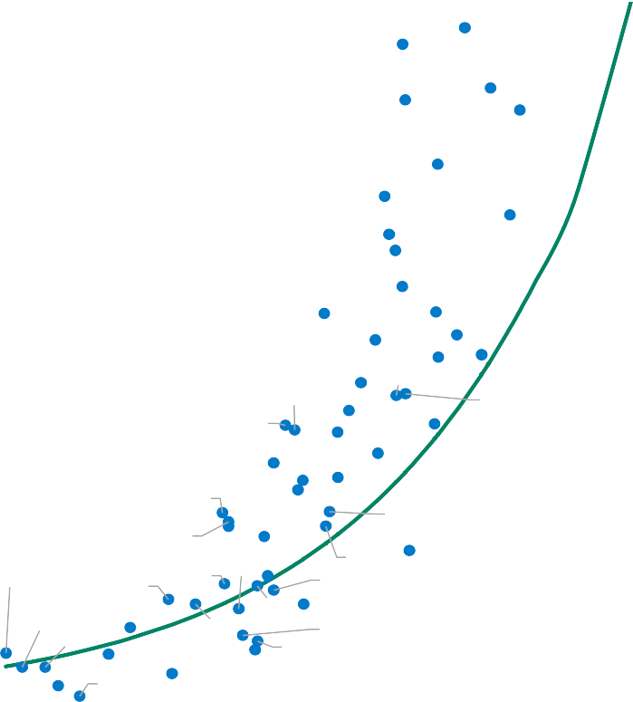
Current Risk Premia Overstates Credit Risk
A Significant Portion of Our Universe Is Trading Cheap Relative To Fair Value Estimates
1,200
CMR
JAM
NAM
TUN
UKR
1,000
HND
BLR
800
ARG
PNG
RWA
UZB
CIV
MNG
Spreads
ARM
EGY
600
TUR
AGO BOL
ZMB
GEO
BRA
COL
SEN
BRB
MAR
ECU PAK
BHR
DOM PRY
400
RUS MEX
KAZ
Spread
Fair Value
GTM
ROU
QAT
OMN
AZE
IND
ZAF CRI TTO
GHA
200
PER CHL
URY
SAU
ARE
MYS
VNM HUN
CHN POL
PAN
IDN
0
KWT
0
10
20
30
40
50
60
70
80
90
Score
Data as of June 30, 2022.
Source: William Blair. Score is the output of our quantitative model that ranks the creditworthiness of all the countries in our universe from 0 to 100.
001AD6FD
15

Slide 16
Why Invest In Emerging Markets Debt?
Improving Growth Stabilizes Credit Metrics
GDP Growth
Fiscal Deficit
■ 2020  2021  2022  2023
Basic Balance
Debt/GDP
As of July 30, 2022.
Source: Oxford Economics, J.P. Morgan, William Blair.
001D872E
16

Slide 17
Multilateral & Bilateral Offer Critical Backstop
Ample Available Funding Limits Scope For Technical Defaults
The IMF’s Firepower
The IMF can lend about $1 trillion to its member countries. This money comes from three different sources:
1st
Line of Defense: Quotas
$440 Billion (SDR 320 Billion)
In normal times, the IMF uses its quota-based resources to finance lending
Line of Defense: Multilateral Borrowing Arrangements
$196 Billion (SDR 143 Billion)
2nd
If the IMF believes that its quota resources might fall short – for example, in the event of a major financial crisis – it can activate the New Arrangements to Borrow (NAB)
Line of Defense: Bilateral Borrowing Agreements
$344 Billion (SDR 250 Billion)¹
3rd
As a third line of defense, the IMF has access to bilateral borrowing arrangements to supplement quotas and NAB resources in case tail risks materialize
¹As of February 2020.
Source: International Monetary Fund, March 2020.
001AD6FC
17

Slide 18
Outlook & Opportunities
0000324B
18

Slide 19
Emerging Markets Debt Hard Currency: Outlook Framework
NEGATIVE
Global Outlook & EMD Fundamentals
Russia/Ukraine conflict creates global uncertainty and exacerbates inflationary pressures
Monetary policy normalization should continue despite growth risks
Raising concerns about a global recession
+ EMD fundamentals remain supportive, despite rising growth risks
+ Commodity exporters benefit from higher prices
+ Strong multilateral and bilateral support
NEGATIVE
Technical Conditions
POSITIVE
Valuations
POSITIVE
Opportunities
‒ Outflows from dedicated EMD portfolios
‒ High levels of market volatility
+ Limited net debt issuance
+ Reduced long investor positioning
+ High investor cash levels
+ Absolute spreads at historical high levels
+ High-Yield/Investment Grade spread differential above long-term average
+ Attractive spread differential versus DM credit
+ Implied probability of default unrealistic in our view
Constructive medium-term view; Despite near-term risks.
Value in high-beta: position for High-Yield/Investment Grade spread compression
Scope for fundamental differentiation, preference for commodity exporters
Opportunities in the EMD Frontier, distressed, and corporate credit spaces
■ Positive  Neutral Negative
As of June 30, 2022.
Not intended as investment advice. Information is current as of the date indicated and is subject to change without notice.
001A5C9A
19

Slide 20
Emerging Markets Debt Hard Currency: Positioning Summary
Select Overweights & Underweights By Beta Bucket
 | Overweight | Underweight
High Beta | Angola Nigeria Egypt | Turkey Honduras Papua New Guinea
Medium Beta | Dominican Republic Romania Colombia | Bahrain Jordan Brazil
Low Beta | Indonesia Kazakhstan United Arab Emirates | China Malaysia Uruguay
As of July 31, 2022. Source: William Blair.
The data shown above is based on the Emerging Markets Debt Hard Currency strategy’s representative portfolio. Holdings are subject to change without notice. Beta segments are based on the team's quantitative and qualitative analysis. Beta segments are provided for illustrative purposes only and are not intended as investment advice or as projections of future returns.
001AD6FE
20

Slide 21
Why Invest In Emerging Markets Debt Now?
Improved Return Potential Based On Attractive Credit Spreads & Higher U.S. Treasury Rates
10-Year UST Yield (%)
 | 2.25 | 2.50 | 2.75 | 3.00 | 3.25 | 3.50 | 3.75
325 | 26.83 | 25.13 | 23.43 | 21.73 | 20.04 | 18.34 | 16.64
350 | 25.13 | 23.43 | 21.73 | 20.04 | 18.34 | 16.64 | 14.95
375 | 23.43 | 21.73 | 20.04 | 18.34 | 16.64 | 14.95 | 13.25
400 | 21.73 | 20.04 | 18.34 | 16.64 | 14.94 | 13.25 | 11.55
450 | 18.34 | 16.64 | 14.94 | 13.25 | 11.55 | 9.85 | 8.16
500 | 14.94 | 13.25 | 11.55 | 9.85 | 8.15 | 6.46 | 4.76
550 | 11.55 | 9.85 | 8.15 | 6.46 | 4.76 | 3.06 | 1.37
Spread
This calculation is the sum of the spread return for each spread level on the left-hand side, the treasury return for each level of U.S. Treasury on the top of the chart, and the current yield of the index. Spread return is defined as spread change from current spread level. *Spread duration of index. Treasury Return is calculated as Treasury yield change. *Treasury duration of index.
Source: William Blair. As of June 2022.
Return and risk information contained herein is intended to illustrate potential expectations for the emerging markets debt asset class and should not be considered any representation of past or expected future return or risk for any William Blair investment strategy or product. Expected returns are provided for informational purposes only and not intended to be reflective of results a person should expect to achieve. Actual results will vary and may be higher or lower than the values indicated. Differences between expected and actual results may be exaggerated in volatile market environments. There is no guarantee that expected return or risk expectations indicated will equal actual return or risk for any specific security or William Blair strategy. Return and risk expectations are hypothetical and are provided for illustrative purposes only. No representation is being made that any account, product, or strategy will or is likely to achieve profits, losses, or results similar to those shown. Return and risk expectations are based on certain estimates and assumptions, which are subject to uncertainty. These expectations are based on models and simulations compiled by the William Blair Emerging Markets Debt team. Hypothetical or simulated performance results have several inherent limitations. Unlike an actual performance record, simulated results do not represent actual performance and are generally prepared with the benefit of hindsight. In addition, since trades have not actually been executed, simulated results cannot account for the impact of certain market risks such as lack of liquidity. There are numerous other factors related to the markets in general or the implementation of any specific investment strategy, which cannot be fully accounted for in the preparation of simulated results and all of which can adversely affect actual results.
FOR INVESTMENT PROFESSIONAL USE ONLY - NOT FOR USE WITH RETAIL INVESTORS
0020B17B
21

Slide 22
Summary
Emerging Markets Debt
Deep, mature and diversified asset class
Underappreciated asset class with scope for strong risk-adjusted returns
Potential for high-income generation
We believe risk premia overcompensates default and loss-given-default risks
22

Slide 23
Glossary ― Terms
Alpha: A measure of a portfolio’s return in excess of the market return, after both have been adjusted for risk. It is a mathematical estimate of the amount of return expected from a portfolio above and beyond the market return at any point in time. For example, an alpha of 1.25 indicates that a stock is projected to rise 1.25% in price in a year over the return of the market, or the return when the market return is zero. When an investment price is low relative to its alpha, it is undervalued, and considered a good selection.
Beta: A quantitative measure of the volatility of the portfolio relative to the overall market, represented by a comparable benchmark. A beta above 1 is more volatile than the overall market, while a beta below 1 is less volatile, and could be expected to rise and fall more slowly than the market.
Convexity: A measure of the sensitivity of a fixed income investment's duration to changes in yield.
Developed Markets: Using the Morgan Stanley Capital International (MSCI) geographic definition, this region includes United Kingdom, Europe (Austria, Belgium, Denmark, Finland, France, Germany, Greece, Ireland, Italy, Netherlands, Norway, Spain, Sweden and Switzerland), Japan, Pacific Asia (Australia, Hong Kong, New Zealand, and Singapore) and the Western Hemisphere (Canada and other Americas).
Duration: A measure of the price sensitivity of a fixed income investment to a change in interest rates, stated in years.
Emerging Markets: Using MSCI’s geographic definition, this region includes Emerging Markets Asia (China, India, Indonesia, Malaysia, S Korea, Taiwan, and Thailand), Emerging Markets Europe, Mid-East and Africa (Czech Republic, Hungary, Poland, Russia, Turkey, Egypt, Morocco, and S Africa), and Latin America (Argentina, Brazil, Chile, Columbia, Mexico, Peru and Venezuela).
Frontier Markets: Less advanced capital markets in the developing world.
FX: In finance, an exchange rate is the rate at which one currency will be exchanged for another. It is also regarded as the value of one country's currency in relation to another currency.
Option-Adjusted Spread (OAS): A measure of the spread of a fixed income investment's yield relative to a benchmark, adjusted to consider an embedded option.
Recovery Rate: The extent to which principal and interest on defaulted debt can be recovered, expressed as a percentage of face value.
Risk (Standard Deviation): A measure of the portfolio’s risk. A higher standard deviation represents a greater dispersion of returns, and thus a greater amount of risk. The annualized standard deviation is calculated using monthly returns.
Spread Duration: A measure of the price sensitivity of a fixed income investment to a change in credit spreads.
Tracking Error: Tracking Error measures the extent to which a portfolio tracks its benchmark. The tracking error of an index portfolio should be lower than that of an active portfolio. The tracking error will always be greater than zero if the portfolio is anything other than a replication of the benchmark.
Yield to Maturity: A representation of the rate of return anticipated on a bond if held until its maturity.
Yield to Worst: A representation of the lowest potential yield that an investor would receive on a bond if the issuer does not default.
001D8724
23

Slide 24
Glossary ― Indices
Bloomberg Barclays US Treasury Index measures US dollar-denominated, fixed-rate, nominal debt issued by the US Treasury.
Bloomberg Barclays US Aggregate Credit Index measures the investment grade, US dollar-denominated, fixed-rate, taxable corporate and government related bond markets. It is composed of the US Corporate Index and a non-corporate component that includes foreign agencies, sovereigns, supranational and local authorities.
Bloomberg Barclays Global Aggregate Index is a flagship measure of global investment grade debt from twenty-four local currency markets. This multi-currency benchmark includes treasury, government-related, corporate and securitized fixed-rate bonds from both developed and emerging markets issuers.
Bloomberg Barclays US Corporate High Yield Index measures the USD-denominated, high yield, fixed-rate corporate bond market.
DAX is a stock index that represents 30 of the largest and most liquid German companies that trade on the Frankfurt Exchange.
FTSE 100 Index, FTSE 100, FTSE, or, informally, the "Footsie" /ˈfʊtsi/, is a share index of the 100 companies listed on the London Stock Exchange with the highest market capitalization.
JP Morgan Emerging Markets Bond Index (EMBI) Global Diversified tracks the total return of U.S.-dollar denominated debt instruments issued by sovereign and quasi-sovereign entities.
JP Morgan Government Bond Index-Emerging Market (GBI-EM) Global Diversified is a comprehensive global local emerging market index, consisting of regularly traded, liquid fixed- rate, domestic currency government bonds.
JP Morgan Corporate Emerging Markets Bond Index (CEMBI) Diversified is a uniquely-weighted version of the CEMBI index designed to result in more balanced weightings for countries included in the index.
JP Morgan CEMBI Index is a market capitalization weighted index consisting of U.S.-dollar denominated corporate bonds issued by emerging markets entities.
JP Morgan Next Generation Markets Index tracks U.S.-dollar denominated debt issued by sovereign and quasi-sovereign issuers in frontier markets. The index provides a benchmark for the smaller, less liquid population of emerging market credits.
JP Morgan U.S. High Yield Index measures the performance of U.S.-dollar denominated below investment grade corporate debt publicly issued in the U.S. market.
JP Morgan U.S. Investment Grade Corporate Index measures the performance of U.S. investment grade corporate debt.
MSCI EAFE Index is a stock market index that is designed to measure the equity market performance of developed markets outside of the U.S. & Canada.
MSCI Emerging Markets Index is a free float-adjusted market capitalization index that is designed to measure equity market performance in the global emerging markets.
MSCI Euro High Yield Index measures the performance of Euro-denominated, below investment grade bonds.
MSCI World Index is a market cap weighted index of stocks from companies throughout the world and is used as a common benchmark for 'world' or 'global' stock funds intended to represent a broad cross-section of global markets.
Nikkei Index, also commonly referred to as the Nikkei 225, is the most recognized Japanese stock market index. It comprises Japan's top 225 companies that are listed on the Tokyo Stock Exchange. Stocks, also known as equities, represent fractional ownership in a company.
S&P 500 Index is a market-capitalization-weighted index of the 500 largest U.S. publicly traded companies. The S&P is a float-weighted index, meaning company market capitalizations are adjusted by the number of shares available for public trading.
S&P GSCI is a composite index of commodities that measures the performance of the commodity market. The S&P GSCI is the commodity equivalent of stock indexes, such as the S&P 500 and the Dow Jones. The subindices provide investors with reliable and publicly available benchmarks for investment performance in the commodities markets such as energy, agriculture, etc.
Shanghai Stock Exchange (SSE) is the largest stock exchange in mainland China. It is a nonprofit organization run by the China Securities Regulatory Commission (CSRC). Stocks, funds, bonds, and derivatives are all traded on the exchange.
Note: JP Morgan indices: Information has been obtained from sources believed to be reliable, but J.P. Morgan does not warrant its completeness or accuracy. The indices are used with permission. The indices may not be copied, used, or distributed without JP Morgan’s prior written approval. Copyright JPMorgan Chase & Co. All rights reserved.
A direct investment in an unmanaged index is not possible.
001D8725
24

Slide 25
Important Disclosures – Emerging Markets Debt
For use with institutional investors only.
This content is for informational and educational purposes only and not intended as investment advice or a recommendation to buy or sell any security. Investment advice and recommendations can be provided only after careful consideration of an investor’s objectives, guidelines, and restrictions. Any investment or strategy mentioned herein may not be appropriate for every investor. Factual information has been taken from sources we believe to be reliable, but its accuracy, completeness or interpretation cannot be guaranteed. Information and opinions expressed are those of the author(s) and may not reflect the opinions of other investment teams within William Blair. Information is current as of the date appearing in this material only and subject to change without notice. This material may include forecasts, estimates, outlooks, projections and other forward-looking statements. Due to a variety of factors, actual events may differ significantly from those presented.
Performance
Past performance is not indicative of future returns. The information referenced herein is provided for illustrative purposes only, is not intended to represent the past or future performance of any William Blair product or strategy and should not be considered as investment advice or a recommendation by William Blair of any particular security, strategy or investment product. Indices are unmanaged, do not incur fees or expenses, and cannot be invested in directly.
Risk
Investing involves risks, including the possible loss of principal. Investing in foreign denominated and/or domiciled securities may involve heightened risk due to currency fluctuations, and economic and political risks. These risks may be enhanced in emerging and frontier markets. Investing in the bond market is subject to certain risks including market, interest rate, issuer, credit, and inflation risk. Rising interest rates generally cause bond prices to fall. Sovereign debt securities are subject to the risk that an entity may delay or refuse to pay interest or principal on its sovereign debt because of cash flow problems, insufficient foreign reserves, or political or other considerations. High-yield, lower-rated, securities involve greater risk than higher-rated securities; portfolios that invest in them may be subject to greater levels of credit and liquidity risk than portfolios that do not. Derivatives may be subject to certain risks such as leveraging, liquidity, interest rate, credit, counterparty, management and the risk of mispricing or improper valuation. Diversification does not ensure against loss.
Copyright © William Blair & Company L.L.C. William Blair is a registered trademark of William Blair & Company, L.L.C.
001A5C8D
25

